Slide 1

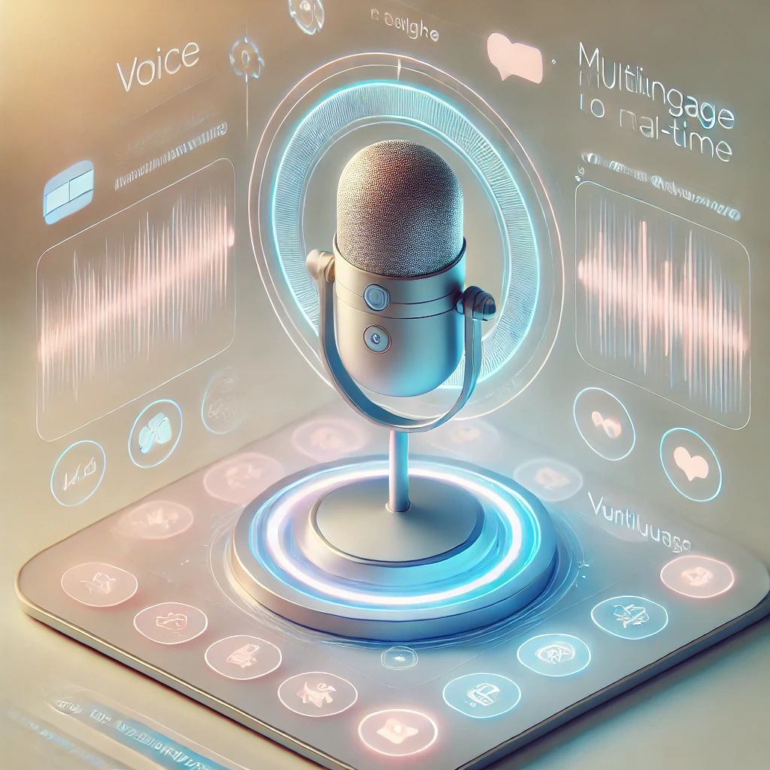

BEYOND_QWERTY
PROJECT
Voice Enabled Form Filling Project
-By Infosys Interns

Slide 2
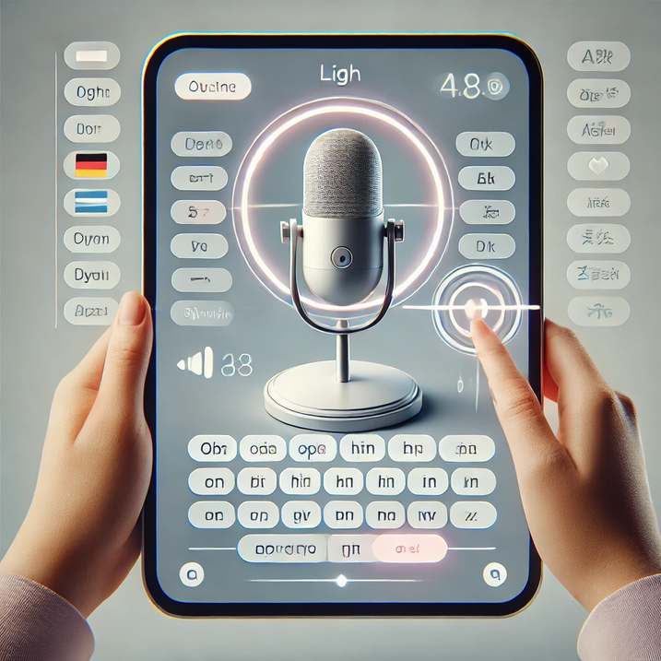
INTRODUCTION
"Beyond QWERTY" is an AI-powered, voice-enabled form-filling system designed to enhance accessibility. Using speech recognition , it allows users to fill forms effortlessly in multiple languages, reducing typing effort and language barriers.
This innovation makes digital interactions seamless, inclusive, and efficient.

Slide 3

PROBLEMS
Traditional form filling is time-consuming and error-prone.
Typing difficulties for non-tech users, elderly individuals, and differently-abled people.
Language barriers make it hard for vernacular users to fill forms.
Need for a voice-enabled, AI-powered solution to simplify the process.

Slide 4
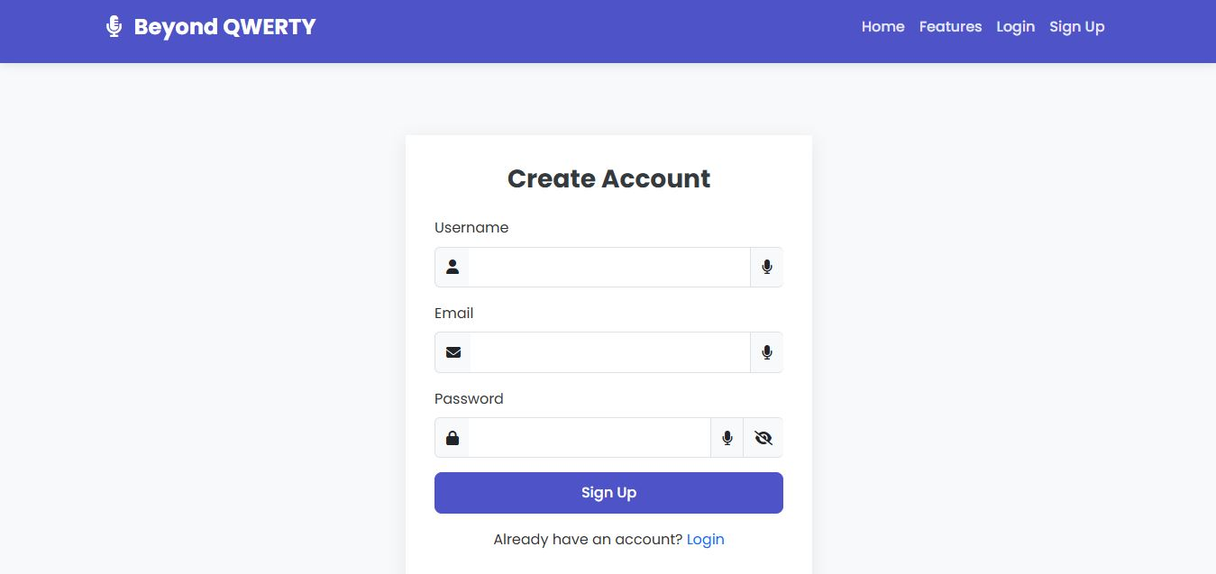
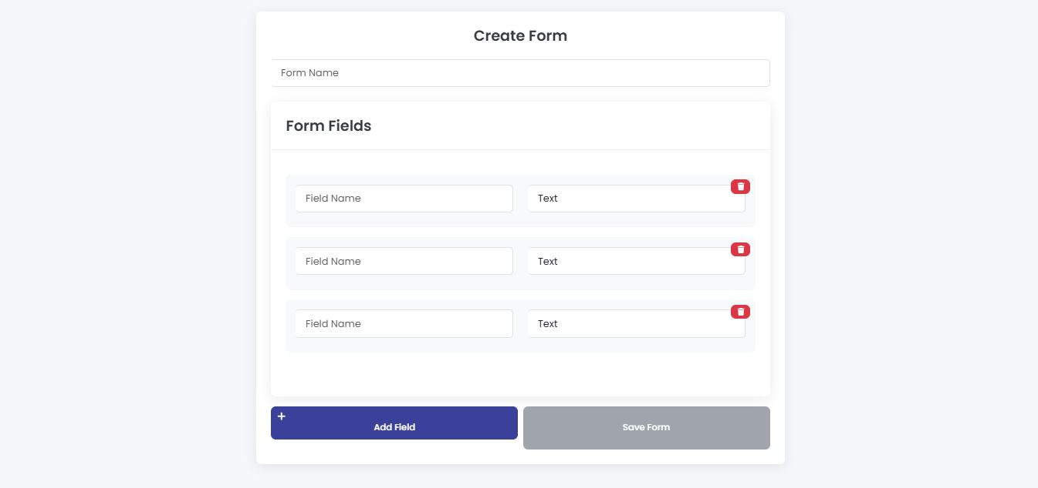
SOLUTION
✅ Voice-Enabled Form Filling – Users can speak instead of typing, making the process faster and more convenient.
✅ AI-Powered Error Correction – NLP ensures accurate text input, reducing mistakes in form entries.
✅ User-Friendly Interface – Simple and intuitive UI for easy navigation, even for non-tech users.
✅ Accessibility for All – Designed to assist elderly users and differently-abled individuals.

Slide 5

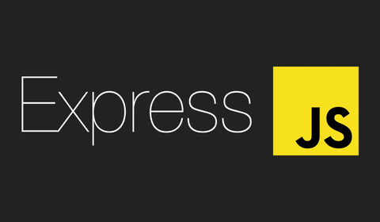

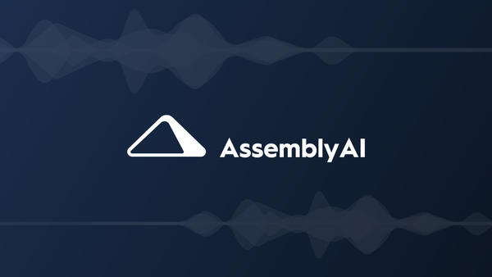
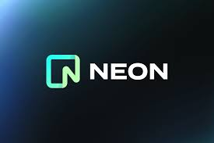
TECHNOLOGY STACK
FULL STACK
Frontend: React.js (Hosted on Vercel)
Backend: Express.js (Hosted on Render)
AI SERVICES
Gemini (For AI-driven text processing)
AssemblyAI (For speech-to-text conversion)
DATABASE
NeonDB (For storing structured data)

Slide 6
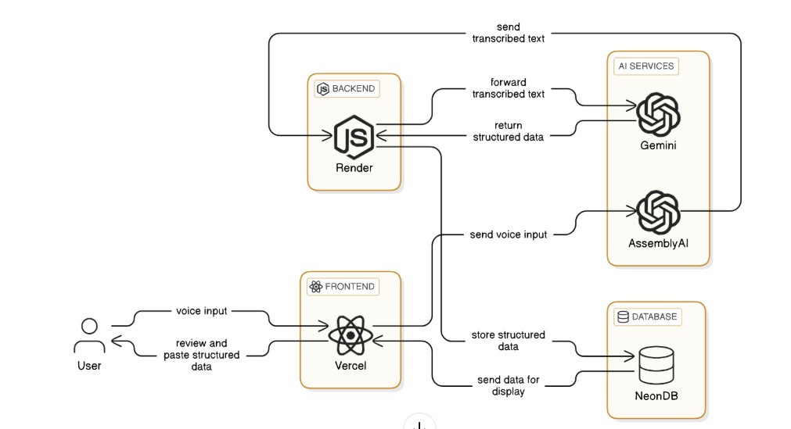
SYSTEM ARCHITECTURE

Slide 7
KEY HIGHLIGHTS
FEATURES
BENEFITS
✔️ Increased Accessibility
✔️ Higher Accuracy
✔️ User-Friendly
✔️ Boosts Productivity
✅ Multi-Language Support
✅ AI-Powered Processing
✅ Real-Time Error Detection
✅ Seamless Integration

Slide 8
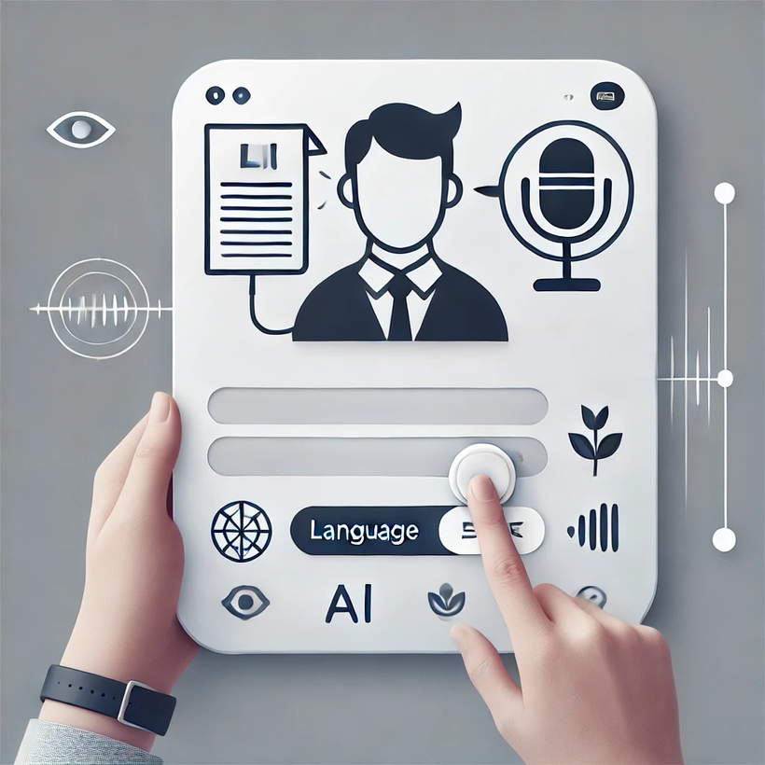
APPLICATIONS
Government Services
Healthcare
Banking & Finance
E-commerce
Education

Slide 9

DATA ANALYSIS
AI-powered voice input is rapidly expanding across industries.
High demand for accessibility & multilingual support.
The speech recognition market is growing at 15%+ CAGR.
Businesses & governments are adopting AI-driven form automation.

Slide 10
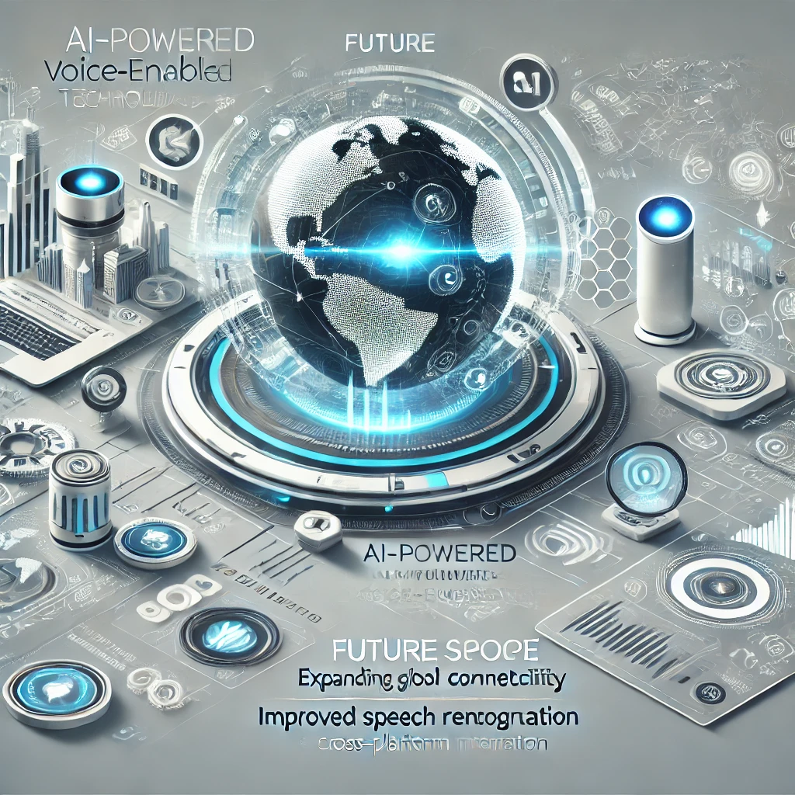
FUTURE SCOPE
🌍 Global Expansion – Support for more languages & dialects.
🧠Advanced AI–Improved speech recognition & NLP accuracy
📲Cross-Platform Integration– Mobile, web, and smart devices
🔒Enhanced Security–Stronger encryption & compliance measures.
🤖 AI Automation– Smart suggestions & predictive form-filling.

Slide 11
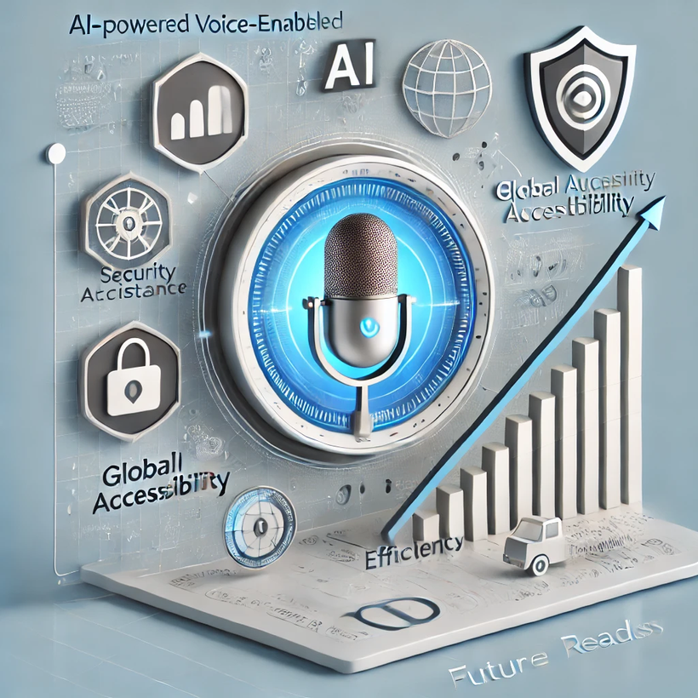
CONCLUSION
Efficient & Accessible – Voice-enabled form filling reduces manual effort, making it faster and easier for all users.
Inclusive & Scalable – Supports multiple languages and adapts to diverse user needs, enhancing digital accessibility.
Secure & Future-Ready – Ensures data privacy while leveraging AI for improved accuracy and seamless integration across platforms.

Slide 12
THANK YOU

